Slide 1
Backpropagation
Paul Cristea
“Politehnica” University of Bucharest
Digital Signal Processing Laboratory
e-mail: pcristea@dsp.pub.ro

Slide 2
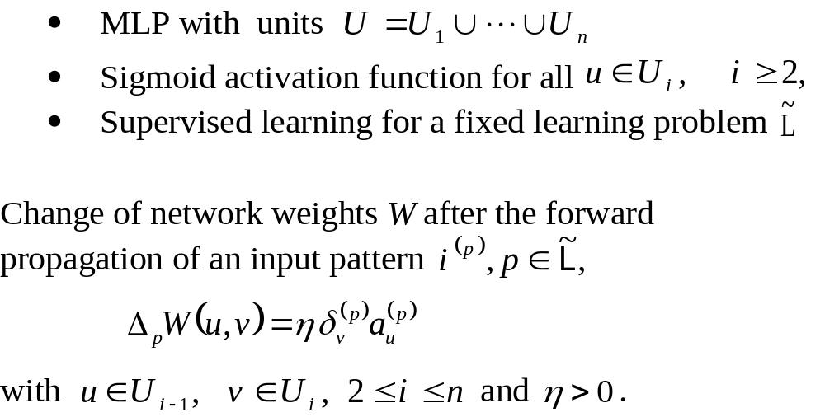
Backpropagation - The Generalized Delta Rule

Slide 3
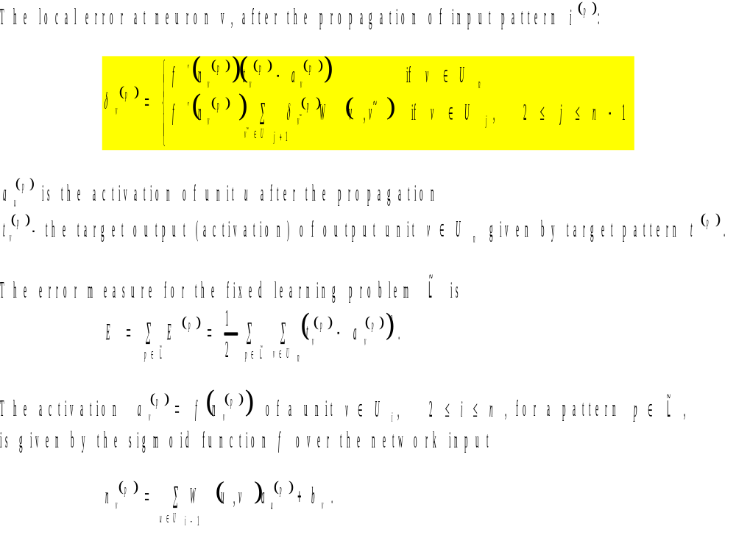

Slide 4
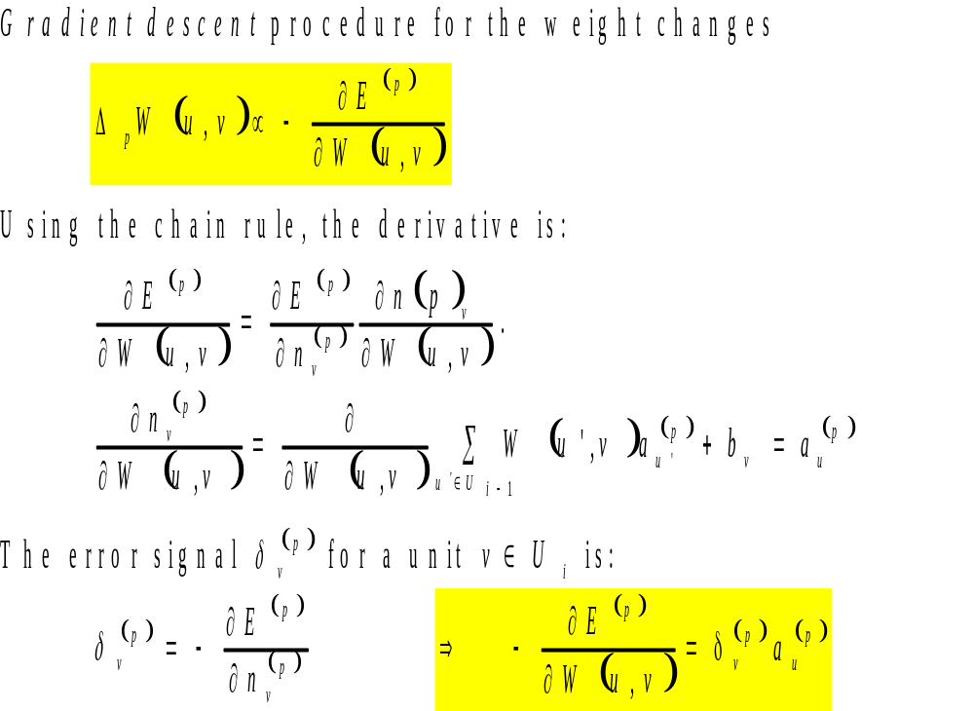

Slide 5
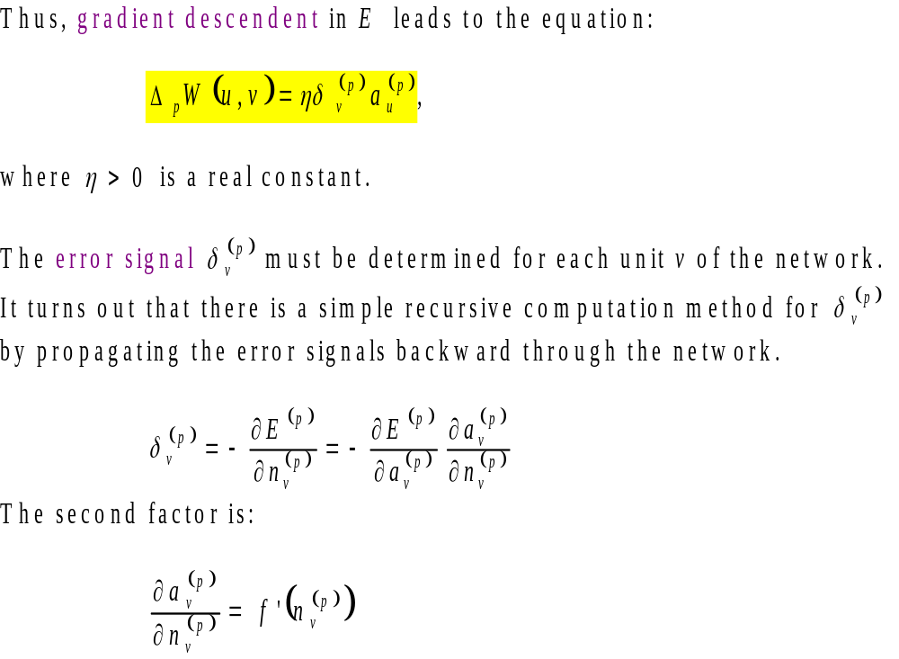

Slide 6
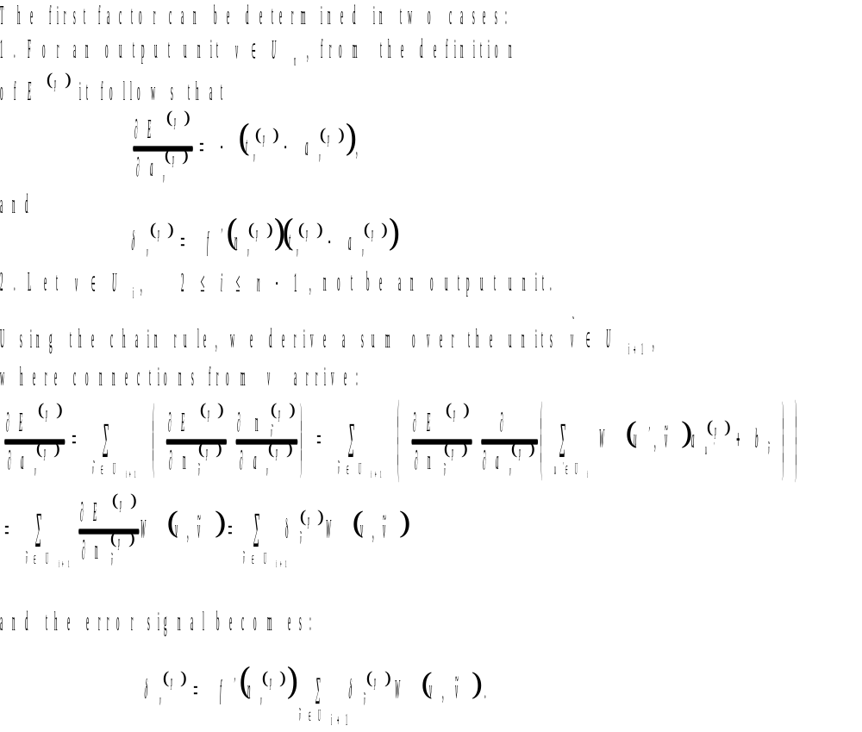

Slide 7
